Slide 1
Range Extension with Optimal Traction Control for Multi E-Axle Based Heavy Duty Vehicle

Slide 2
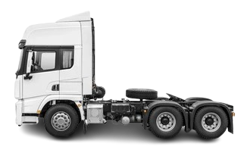


















Proposed Control Scheme
Powertrain Level: Optimal Torque Allocation
Vehicle Level: Optimal Driving Torque
$$Ω_{EM}^{∗}=\min_{1−η}{\int{p_{loss}dt}}$$
Road Grade
$$\left(τ_{dr}^{∗},a_{v}^{∗}\right)=\min_{a_{veh}}{\int{pdt+Δv^{2}}}$$
Optimal driving torque
$$\left(τ_{dr}^{∗},ω_{w}\right)$$
$$\left(τ_{dr}^{∗},ω_{w}\right)$$
$${Ω_{Ax}^{∗}τ}_{EM}^{∗}$$
Speed Limit
$${{(1−Ω}_{Ax}^{∗})τ}_{EM}^{∗}$$
$$v^{∗}$$
$$F_{resistive}=F_{r}+F_{drag}+F_{grade}$$
E-Axle supervisory
Control
$$F_{r}=c_{r}⋅m⋅g⋅cos(α)$$
Wrapping Function
Actuation Limit
$$F_{drag}={\frac{1}{2}⋅ρ⋅c}_{d}⋅A_{f}⋅v_{veh}^{2}$$
$$Ω_{Ax}^{∗}$$
Constraint, param.
$$a^{∗}$$
$$F_{grade}=m⋅g⋅sin(α)$$
SQP Routine
$$a$$
Cost Function
$$p=F_{resistive}⋅v$$
$$J$$
$$ω_{m}$$
Current Mapping
Current Controller
In first step it calculates optimal acceleration to find optimal driving torque
In second step, it allocates the torque optimally to all e–axles
In third step, it addresses the challenges caused by uneven torque allocation
EM Control for E-axles (Propulsion and Braking)
$${Ω_{Ax}^{∗}τ}_{EM}^{∗}$$
$$I^{∗}$$
Drive
$$I$$
PMSM
Component Level: EM Control

Slide 3
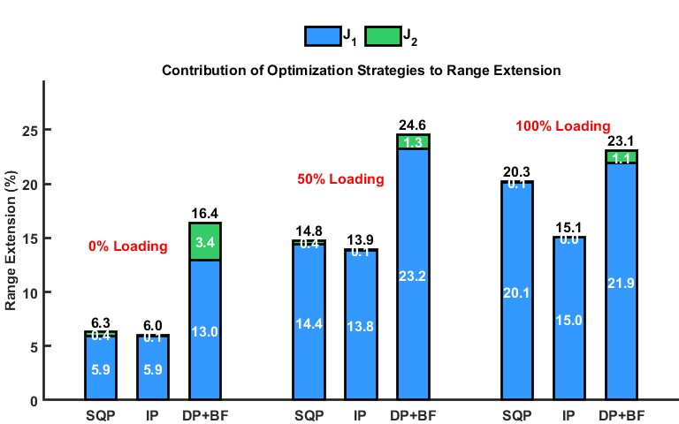
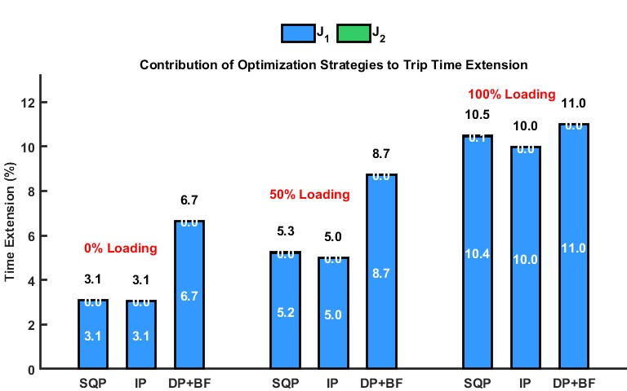
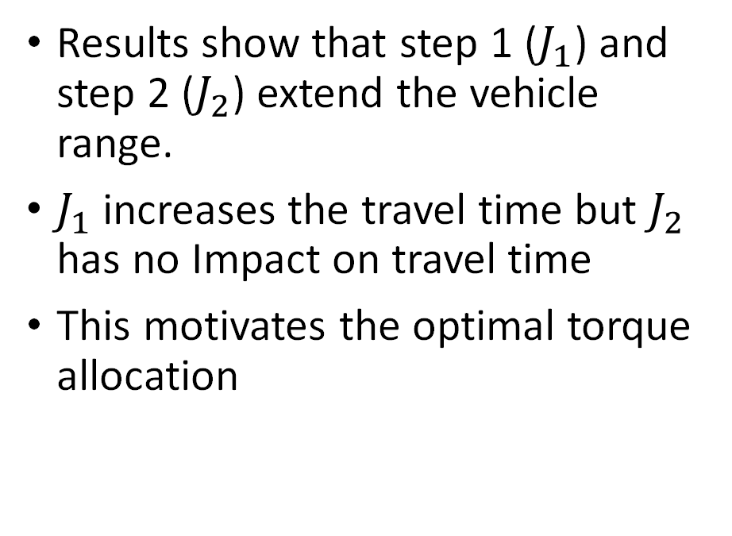
Results
Results show that step 1 ($J_{1}$) and step 2 ($J_{2}$) extend the vehicle range.
$J_{1}$ increases the travel time but $J_{2}$ has no Impact on travel time
This motivates the optimal torque allocation

Slide 4


Torque Allocator Interface with EM controller
Torque allocator assigns the torque both motors
It provides same speed reference to both motors
Torque Allocator
$$τ_{ref1}$$
Current Mapping
$$ω_{m}$$
Current Mapping
$$τ_{ref1}$$

Slide 5
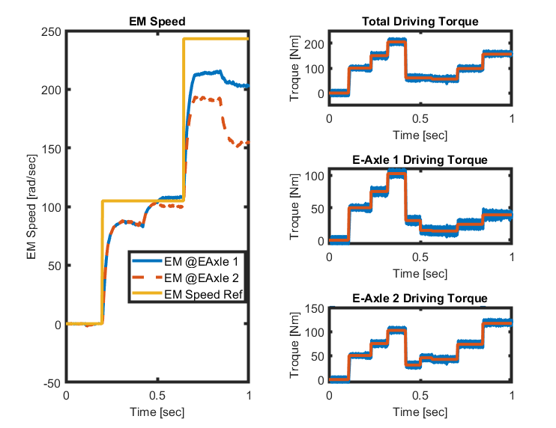
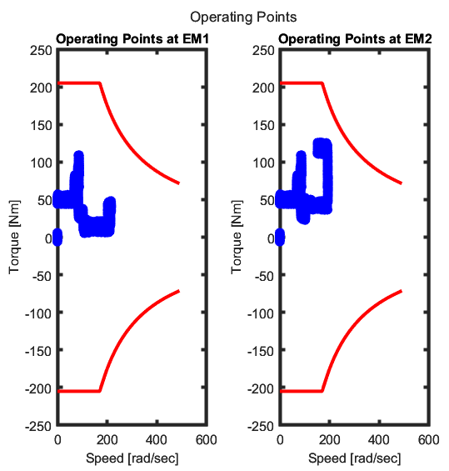
EM response under uneven torque allocation
Uneven torque allocation starts after 0.5 sec
EM controller is unable to drive the Ems at same speed

Slide 6




Speed synchronization Methodology
Torque Allocator
$$τ_{ref1}$$
Current Mapping
Speed synchronizer change the speed reference for both EMs so that output speed of both EMs should be same
$$ω_{ref1}$$
Synchronizer
$$ω_{ref2}$$
Current Mapping
$$τ_{ref2}$$

Slide 7
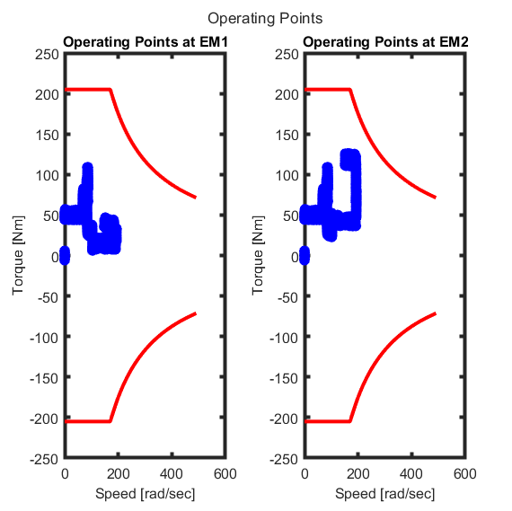
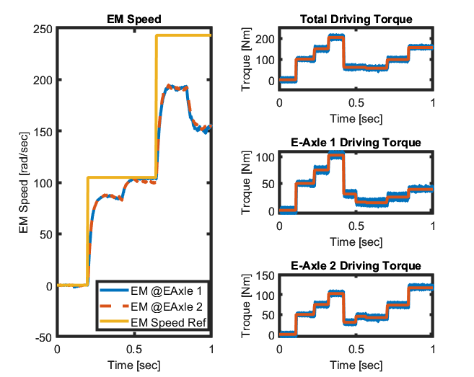
Results with proposed synchronization Methodology

Slide 8
Thank You

